Slide 1
Oulu bakery
Members:
Nguyen Dang Chau
Nguyen Van Cuong

Slide 2
Outline
Problem and vision
User stories
User needs
Sitemap
User Interface
Demo

Slide 3
PROBLEM and vision
Oulu Bakery needs a new application
It is for customers to see the cakes and order them.
That application can run on mobile.

Slide 4
User Stories
See information of the shop (reviews, reputation, etc.)
See the catalogue
See location and opening hours
Add/Remove items
Pay for the selected items

Slide 5
User needs (DATA)
Information of the shop (reviews, reputation, etc.)
List of cake (description, price, etc.)
List of shop’s location and opening hours

Slide 6
User needs (FUNCTIONAL)
See information of the shop (reviews, reputation, etc.)
See all kinds of cake in the shop
Choose cake to buy
Add cake to shopping cart
Remove cake from cart
Pay with credit card or PayPal
Select time and type of delivery
Find location and opening hours
Follow the shop on Facebook, Twitter, Google Plus, etc.

Slide 7
User needs (contextual)
Computer and internet
Summary of purchases
Payment method (credit card, PayPal, etc.)

Slide 8
SITEMAP
Home
About us
Catalogue
Products
Contact
Shopping cart
Form

Slide 9
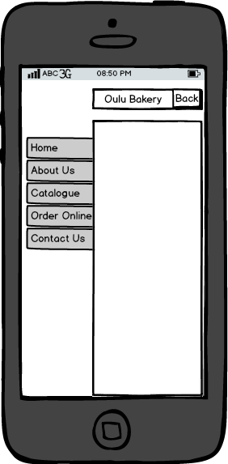
User Interface

Slide 10
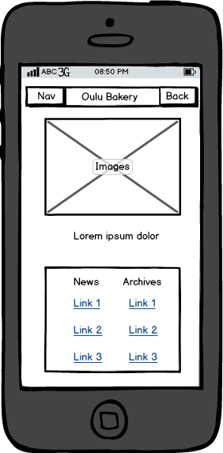
User Interface

Slide 11
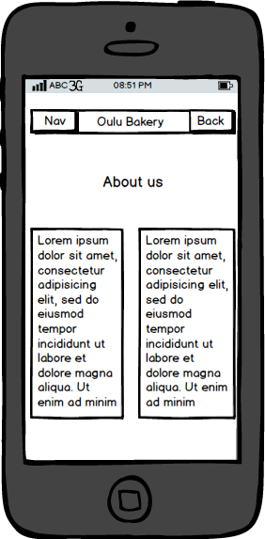
User Interface

Slide 12
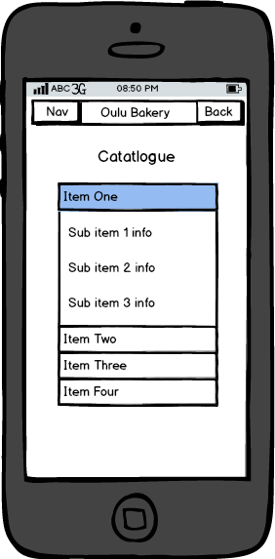
User Interface

Slide 13
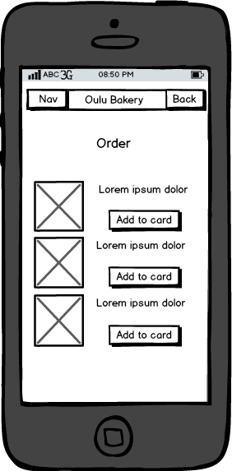
User Interface

Slide 14
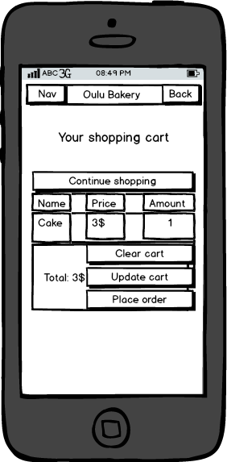
User Interface

Slide 15
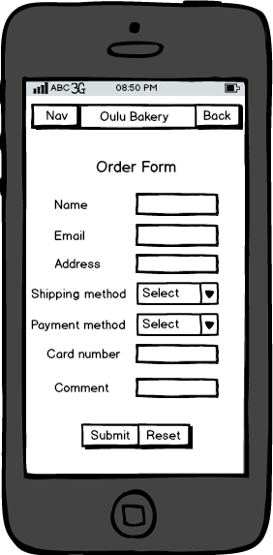
User Interface

Slide 16
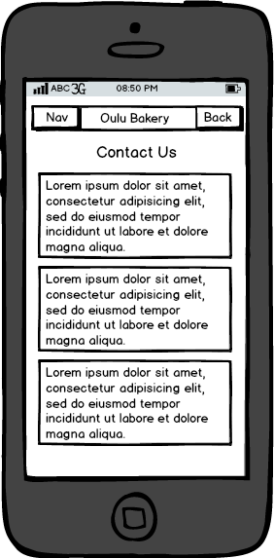
User Interface

Slide 17
DEMO
http://mobiletest.me/#d=iPhone_5_portrait&u=http://82.128.185.146

Slide 18
THANK YOU!

